Slide 1
Big data analytics
1.
2020

Slide 2
Why Big Data analytics?
Big Data are now rapidly expanding in all science and engineering
physical, biological and biomedical sciences
finance
astronomy
transportation
image processing
pattern recognition
fraud detection
marketing

Slide 3
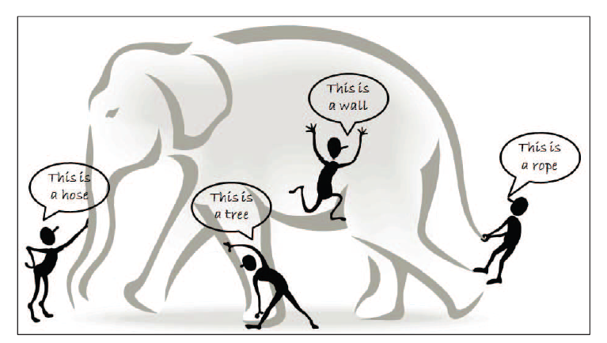
Why Big Data analytics?

Slide 4
BIG DATA CHARACTERISTICS
Imagine that a number of blind men are trying to size up a giant elephant
The goal of each blind man is to draw a picture (or conclusion) of the elephant according to the part of information he collects during the process
Because each person’s view is limited to his local region, it is not surprising that the blind men will each conclude independently that the elephant “feels” like a rope, a hose, or a wall, depending on the region each of them is limited to.
To make the problem even more complicated, let us assume that
the elephant is growing rapidly and its pose changes constantly
each blind man may have his own (possible unreliable and inaccurate) information sources that tell him about biased knowledge about the elephant (e.g., one blind man may exchange his feeling about the elephant with another blind man, where the exchanged knowledge is inherently biased)

Slide 5
BIG DATA CHARACTERISTICS
Exploring the Big Data in this scenario is equivalent to aggregating heterogeneous information from different sources (blind men) to help draw a best possible picture to reveal the genuine gesture of the elephant in a real-time fashion
This task is not as simple as asking each blind man to describe his feelings about the elephant and then getting an expert to draw one single picture with a combined view, concerning that each individual may speak a different language (heterogeneous and diverse information sources) and they may even have privacy concerns about the messages they deliberate in the information exchange process.

Slide 6
BIG DATA CHARACTERISTICS
HACE Theorem
Huge Data with Heterogeneous and Diverse Dimensionality
Autonomous Sources with Distributed and Decentralized Control
Complex and Evolving Relationships

Slide 7
BIG DATA CHARACTERISTICS
Huge Data with Heterogeneous and Diverse Dimensionality
one of the fundamental characteristics of the Big Data is the huge volume of data represented by heterogeneous and diverse dimensionalities
different information collectors prefer their own schemata or protocols for data recording, and the nature of different applications also results in diverse data representations
heterogeneous features refer to the different types of representations for the same individuals, and the diverse features refer to the variety of the features involved to represent each single observation

Slide 8
BIG DATA CHARACTERISTICS
Autonomous Sources with Distributed and Decentralized Control
each data source is able to generate and collect information without involving (or relying on) any centralized control
similar to the World Wide Web (WWW) setting where each web server provides a certain amount of information and each server is able to fully function without necessarily relying on other servers
for major Big Data-related applications, such as Google, Flicker, Facebook, and Walmart, a large number of server farms are deployed all over the world to ensure nonstop services and quick responses for local markets

Slide 9
BIG DATA CHARACTERISTICS
Complex and Evolving Relationships
major social network sites, such as Facebook or Twitter, are mainly characterized by social functions such as friend-connections and followers. The correlations between individuals inherently complicate the whole data representation and any reasoning process on the data. In the sample-feature representation, individuals are regarded similar if they share similar feature values, whereas in the sample-feature-relationship representation, two individuals can be linked together (through their social connections) even though they might share nothing in common in the feature domains at all. In a dynamic world, the features used to represent the individuals and the social ties used to represent our connections may also evolve with respect to temporal, spatial, and other factors.
Such a complication is becoming part of the reality for Big Data applications, where the key is to take the complex (nonlinear, many-to-many) data relationships, along with the evolving changes, into consideration, to discover useful patterns from Big Data collections

Slide 10
BIG DATA CHARACTERISTICS – 3Vs
3Vs refers to three-dimensional properties of Big data
Volume of the data
Variety of the data
Velocity of accessing the data

Slide 11
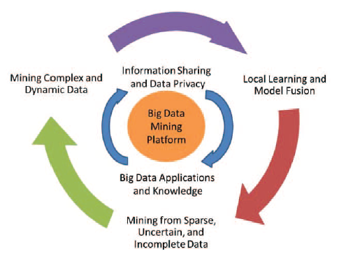
DATA MINING CHALANGES WITH BIG DATA
For an intelligent learning database system to handle Big Data, the essential key is to scale up to the exceptionally large volume of data and provide treatments for the characteristics featured by the aforementioned HACE theorem and 3Vs Big Data Characteristics
a conceptual view of the Big Data processing framework, which includes three tiers from inside out with considerations on
data accessing and computing (Tier I)
data privacy and domain knowledge (Tier II)
Big Data mining algorithms (Tier III)

Slide 12
DATA MINING CHALANGES WITH BIG DATA
Tier I: Big Data Mining Platform
In typical data mining systems, the mining procedures require computational intensive computing units for data analysis and comparisons. A computing platform is, therefore, needed to have efficient access to, at least, two types of resources: data and computing processors. For small scale data mining tasks, a single desktop computer, which contains hard disk and CPU processors, is sufficient to fulfill the data mining goals. Many data mining algorithm are designed for this type of problem settings.
For medium scale data mining tasks, data are typically large (and possibly distributed) and cannot be fit into the main memory. Common solutions are to rely on parallel computing or collective mining to sample and aggregate data from different sources and then use parallel computing programming (such as the Message Passing Interface) to carry out the mining process.

Slide 13
DATA MINING CHALANGES WITH BIG DATA
Tier I: Big Data Mining Platform
For Big Data mining, because data scale is far beyond the capacity that a single personal computer (PC) can handle, a typical Big Data processing framework will rely on cluster computers with a high-performance computing platform, with a data mining task being deployed by running some parallel programming tools, such as MapReduce or Enterprise Control Language (ECL), on a large number of computing nodes (i.e., clusters). The role of the software component is to make sure that a single data mining task, such as finding the best match of a query from a database with billions of records, is split into many small tasks each of which is running on one or multiple computing nodes.

Slide 14
DATA MINING CHALANGES WITH BIG DATA
Tier II: Big Data Semantics and Application
Semantics and application knowledge in Big Data refer to numerous aspects related to the regulations, policies, user knowledge, and domain information. The two most important issues at this tier include
1) data sharing and privacy
2) domain and application knowledge.
The former provides answers to resolve concerns on how data are maintained, accessed, and shared; whereas the latter focuses on answering questions like “what are the underlying applications ?” and “what are the knowledge or patterns users intend to discover from the data ?”

Slide 15
DATA MINING CHALANGES WITH BIG DATA
Tier III: Big Data Mining Algorithms
Local Learning and Model Fusion for Multiple Information Sources
As Big Data applications are featured with autonomous sources and decentralized controls, aggregating distributed data sources to a centralized site for mining is systematically prohibitive due to the potential transmission cost and privacy concerns.
On the other hand, although we can always carry out mining activities at each distributed site, the biased view of the data collected at each site often leads to biased decisions or models, just like the elephant and blind men case.
Under such a circumstance, a Big Data mining system has to enable an information exchange and fusion mechanism to ensure that all distributed sites (or information sources) can work together to achieve a global optimization goal.

Slide 16
DATA MINING CHALANGES WITH BIG DATA
Tier III: Big Data Mining Algorithms
Mining from Sparse, Uncertain, and Incomplete Data
Spare, uncertain, and incomplete data are defining features for Big Data applications. Being sparse, the number of data points is too few for drawing reliable conclusions. This is normally a complication of the data dimensionality issues, where data in a high-dimensional space (such as more than 1,000 dimensions) do not show clear trends or distributions.
Uncertain data are a special type of data reality where each data field is no longer deterministic but is subject to some random/error distributions. This is mainly linked to domain specific applications with inaccurate data readings and collections

Slide 17
DATA MINING CHALANGES WITH BIG DATA
Tier III: Big Data Mining Algorithms
Mining Complex and Dynamic Data
Complex and dynamic dependency structures underneath the data raise the difficulty for the learning systems

